Slide 1
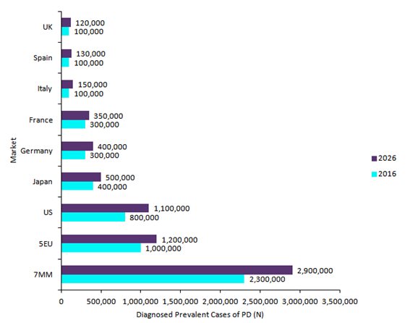
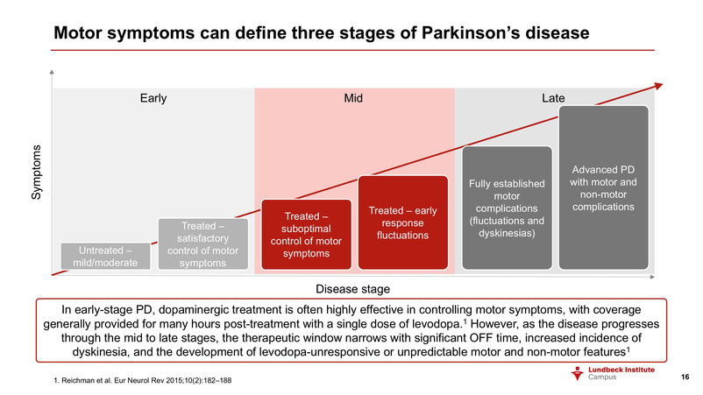
Background
Parkinson's disease (PD)
A brain disorder; Occurs when neurons that control movement become impaired
=> Production of less dopamine
Symptoms begin gradually and get worse over time
Involuntary tremor majorly in hands, arms, and legs
Muscle stiffness
Bradykinesia (slowness of movement)
About 95-96% of PD patients are diagnosed around the age of 60
The second most common degenerative neurological disorder after Alzheimer’s disease
After at least 10 years of PD, patients have an increased disease burden & a greater impairment in quality of life
Wear-off effect of medication through mid to late stages of PD
Current treatments do not perfectly cure PD
Notes:
Claire
Risk factor mostly age
About 1 million Americans & 10 million people worldwide are living with PD
Side effects from surgery (DBS) & long-term use of medication (Levodopa)
Depression, anxiety, dementia

Slide 2
Existing Solutions
Physical Therapy
Transcutaneous Electric Muscle Stimulation
Functional Electric Stimulation
Neuromuscular Electric Stimulation
Electric Muscle Stimulation using a medium-frequency band
Medication
Duopa: Levodopa + Carbidopa
Dopamine agonists
COMT
Antidepressant
Surgery
Deep Brain Stimulation
Pallidotomy
Thalamotomy
Focused Ultrasound
Physical Therapy
Early onset for Parkinson’s
Medication
Medication Side Effects
Surgery
Brain damage
Surgical Errors
Highly invasive

Slide 3
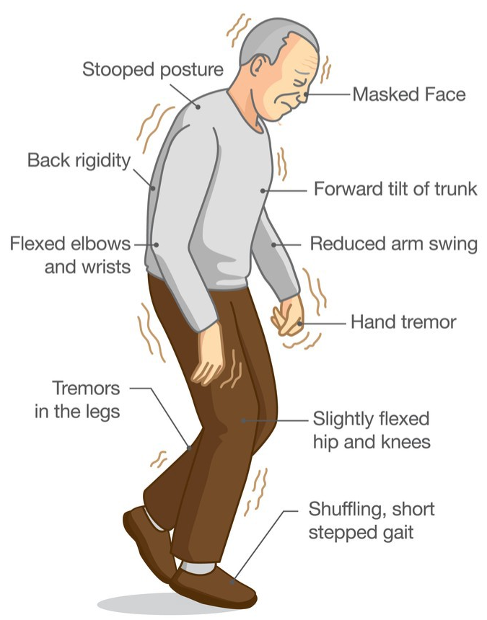
Stakeholders
Physical Therapist at Senior Care Center
Alleviating / Preventing major motor symptoms of PD is significant to reduce the chance of developing complications
Importance of muscle stimulation technique
Help patients’ muscles keep moving => preventing further progression of motor symptoms
Caregiver of PD patient
Need something that can be easily & regularly utilized by patients w/o help of any professionalists
Elderly patients => Difficulty in visiting the hospital on a regular basis
Need something that do not directly impact the internal system of body
Medication side effects & misuse
Physician & Scientific Operations Technologist for neurodegenerative disorders
The average medication cycle mandates aerobic exercises and physiotherapy throughout the progression
Stimulation of muscles
Dampen the major motor symptoms for the early to medium stages of PD
↑ in lifespan (10-15 years) w/o losing their mental and physical faculties
Notes:
Claire
Eating problems (chewing & swallowing)
Sleep disorders (rapid eye blinking
Constipation
Dizziness, orthostatic hypotension
Mental storm, derangement, diminished cognitive functions

Slide 4
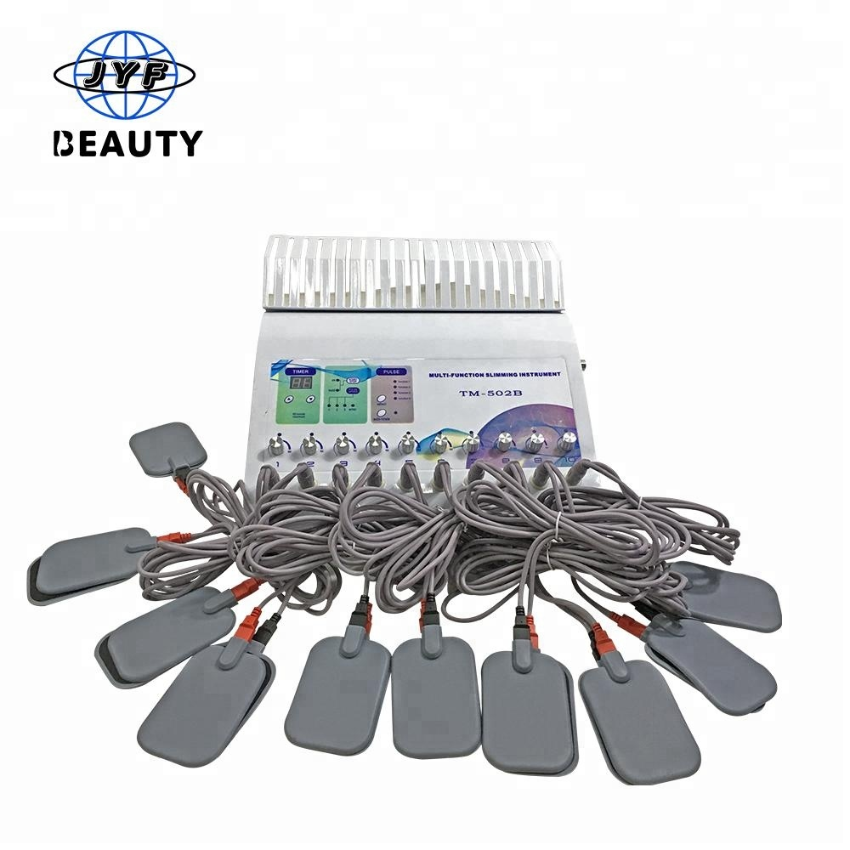
Problem Solution
Electrical Muscle Stimulation (EMS)
Elicitation of muscle contraction using electric impulses through electrode pads on the skin near to the muscles being stimulated
Mimic the action potential that comes from the central nervous system (CNS), causing muscle contraction
Used as a rehabilitation and preventive tool for patients (or sometimes muscle training for the athletes)
Modulation of peripheral reflex mechanism by EMS
Improving resting tremor & muscle rigidity temporarily
May ultimately reduce the severity of Bradykinesia
Current EMS (FDA-Certified): over-the counter devices (OTC) & prescription devices
Our Plan
Small electrode pads (4 cm X 4 cm) => longer & wider electrode pads
Complex system with a large machine + many lead plug wires => compact & portable system
Wearable
Rechargeable & Reusable
Notes:
Claire
OTC devices are marketable only for muscle toning; prescription devices can be purchased only with a medical prescription for therapy

Slide 5
Industrial Design Specifications
List your Industrial Design Specifications and justify how each addresses the need
Notes:
Rad

Slide 6
Product Design Specifications
Notes:
Rad

Slide 7
Looks-like Prototype
Show your looks-like prototype
Describe how it satisfies your industrial design specifications
Notes:
Cainwyn

Slide 8
Works-like Prototype
Show your works-like prototype and describe the functionality
Describe how it satisfies your product design specifications
Notes:
Cainwyn

Slide 9
Failure Analysis
Possible failure mechanisms & limitations
Electro pads malfunction
Device limited to treatment for patients within the first stages of PD
Mild improvements
Future tests
100 Clinical Trials for Patients diagnosed with PD
Optimizing best padding positions through trials
De-risk
Timely Interval pad switch
Remaining routine practice with device during the first stages of patient’s prognosis
Future improvements
Electrical stimulation for neuronal improvements
Electrical stimulation for greater treatment
Notes:
Selina

Slide 10
Materials Selection
Notes:
Rad

Slide 11
Conclusions
What could the impact of your product be if you brought it to market?
Not expensive, Easily accessible w/ prescription,
FDA regulatory pathway: Class II
What challenges might you run into if you were to bring your product to the market?
Teaching them how to use the product (old people)

